Slide 1
Think critically
Learn about these theories and frames and then… play cards with them
Intellectual disability, quality of life and individualized supports
VU - Key strategies for disability and neuropathy
24 September 2015
Sofie Sergeant – sofie.sergeant@disabilitystudies.nl

Slide 2
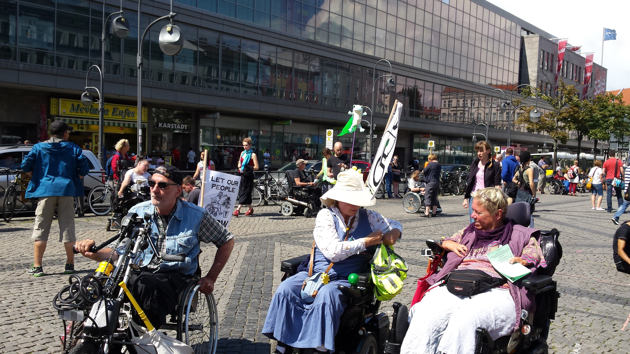
Diversity ≈ Richness

Slide 3
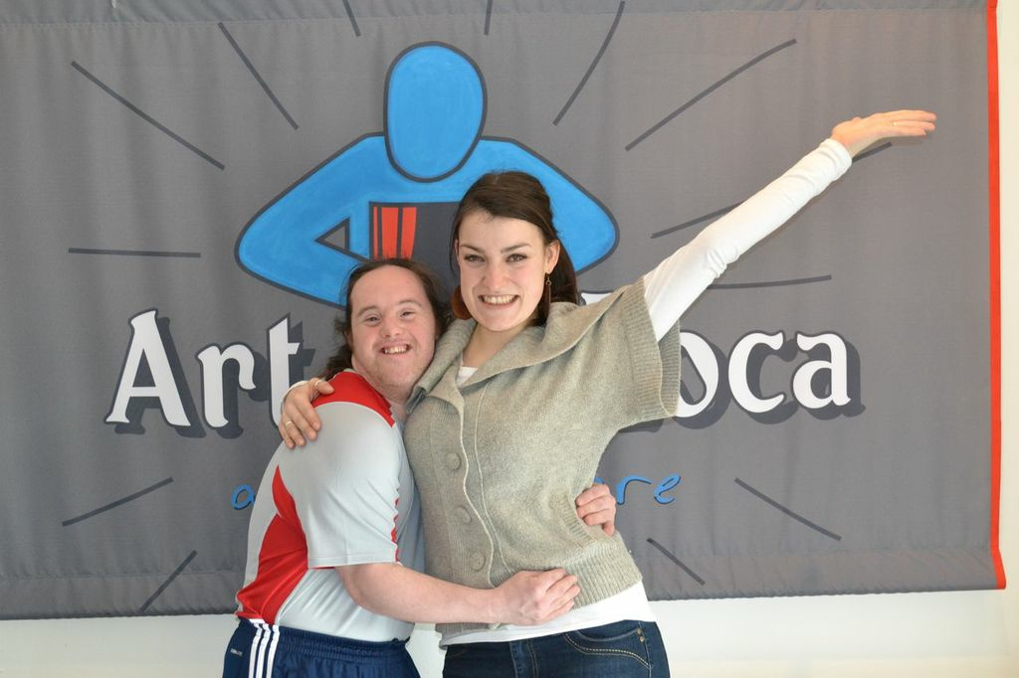
Diversity ≈ Richness

Slide 4
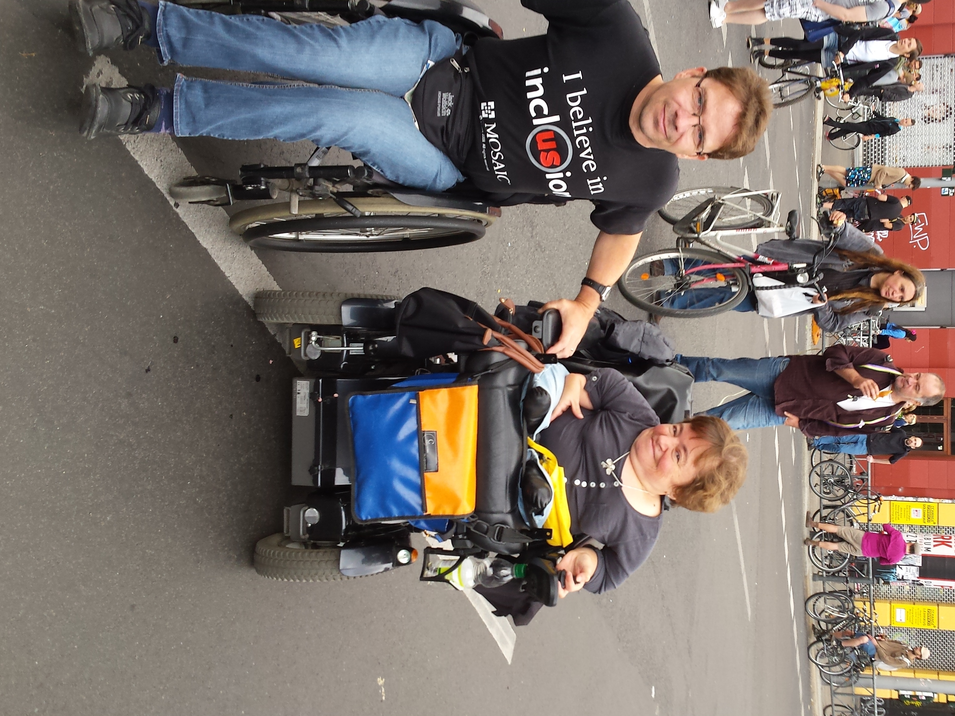
Diversity ≈ Richness

Slide 5
Today
The nature of intellectual disability
The meaning of personal well-being
The important role of individualized support in QOL
?
How do you think an individual support plan should be created?

Slide 6
Introduction
Picture books
Saar De Buysere en Sofie Sergeant

Slide 7
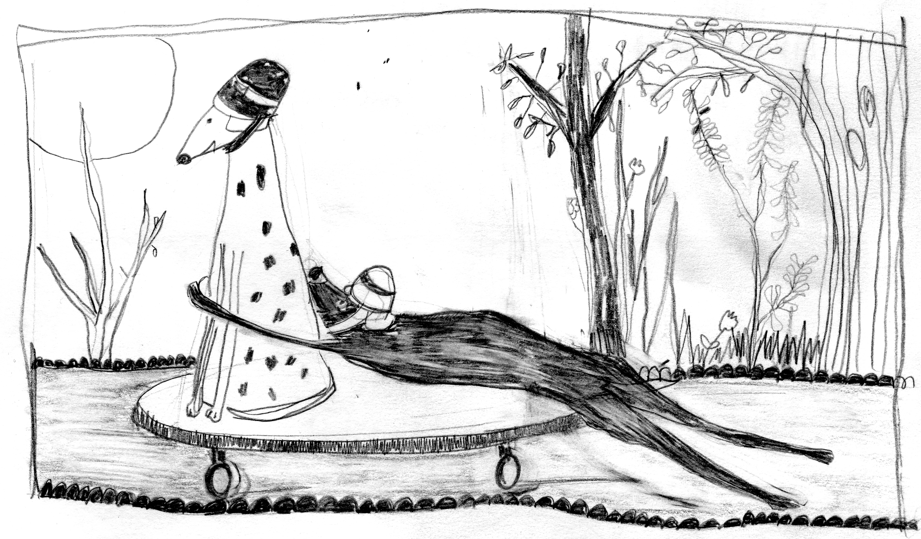
Dingske (Thingie), Garant, 2010
Nu en straks (Now and later), Garant, 2013
Et maintenant, Garant, 2014
Jonge honden in „Verhalen voor het sterven gaan“
(Stories before dying), Vrijdag, 2014
Achter de rouw (Behind the mourning), Witsand, 2015
Picture books

Slide 8
Why?
People with intellectual disabilities tend to have a nontraditional style of reading - we really should encourage care takers towards other means of communication
In support: caring -> coaching to participate in society
Dialogue: more important
Notes:
Accent is moving towards supporting people to engage in regular activities, organizations, work and ‚living in the society‘

Slide 9
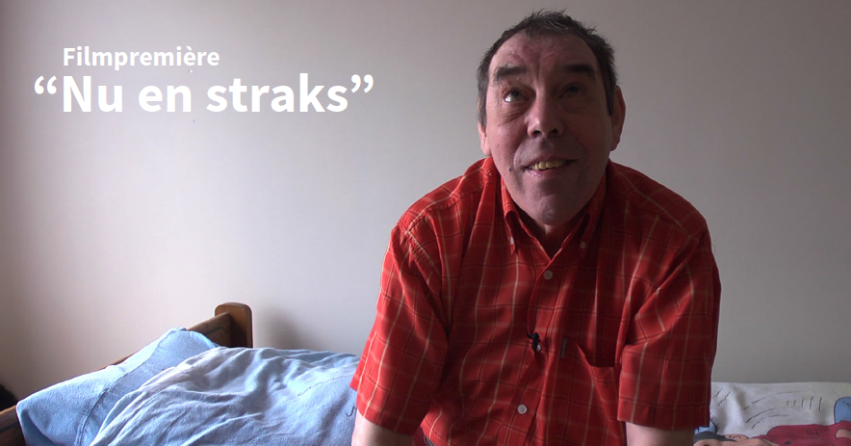
Now and later – the film

Slide 10
3 questions
What hit you in the film on…
the nature of intellectual disability
The meaning of personal well-being
The important role of individualized support in QOL

Slide 11
Historical context
Last 30 years:
3 developments in the field of ID
Social-ecological conception of disability
! Interactions between personal and environmental characteristics
The inportance of focusing on a person´s quality of life
Individualized supports

Slide 12
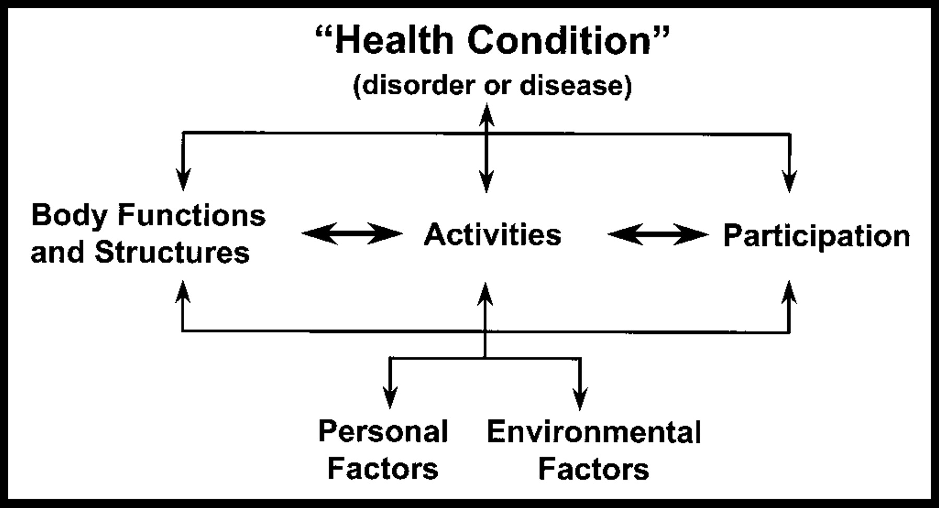
Intellectual disability
2001: WHO (World Health Organization) presents
ICF-model (The International Classification of Functioning, Disability and Health)
-> bio-psycho-social approach
-> multiple perspective
->person-environment interaction

Slide 13
Intellectual disability
Significant limitation in
intelligence and adapative skills
Health
Participation
Context – Education – Culture – Background

Slide 16
AAIDD Model

Slide 17
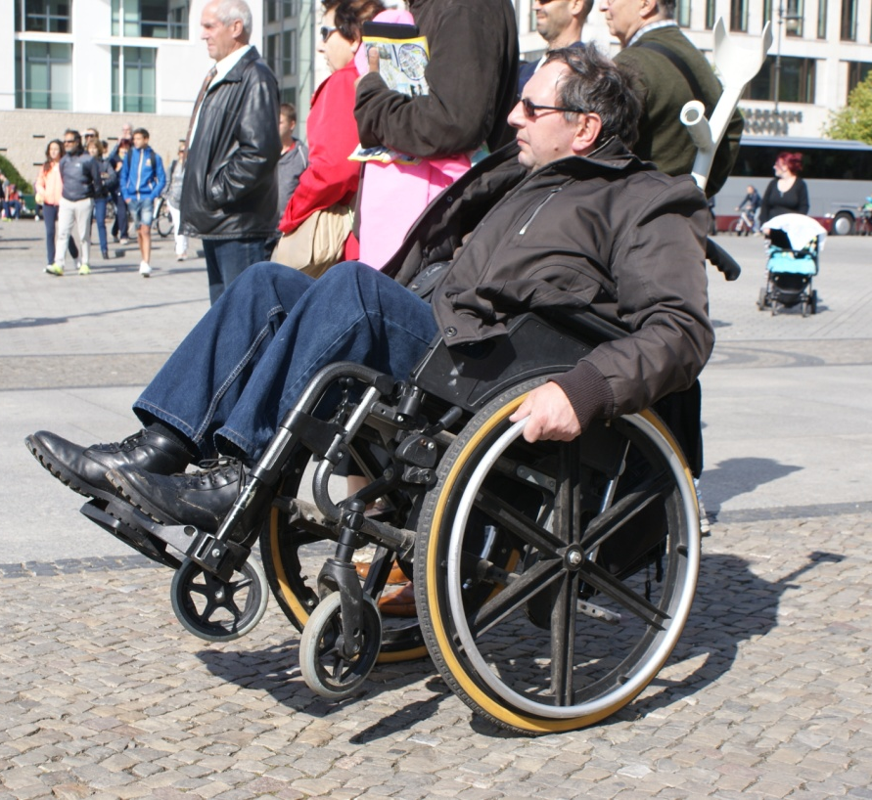
Quality of life - Model
Rights (access and privacy)
Participation
Autonomy, independence and choice
Physical well-being
Material well-being
Social inclusion - accessibility
Emotional well-being
Personal development – education - habilitation
-> objective and personal subjective conditions of life are entangled
-> focus: equity, empowerment and life satisfaction

Slide 18
Quality of life – model: Robert L. Schalock

Slide 19
Individualized Supports
Support needs = basis of individualized education and habilitation planning
The level or intensity of a person´s support needs = basis for planning and finding resources
Person-centered planning, personal growth, community inclusion and empowerment

Slide 20
Universal Design Model
“Universal Design involves designing products and spaces so that they can be used by the widest range of people possible. Universal Design evolved from Accessible Design, a design process that addresses the needs of people with disabilities. Universal Design goes further by recognizing that there is a wide spectrum of human abilities. Everyone, even the most able-bodied person, passes through childhood, periods of temporary illness, injury and old age. By designing for this human diversity, we can create things that will be easier for all people to use.”
(www.universaldesign.com)

Slide 21
VAKOG
All senses are involved:
 Visual
 Auditory
 Kinesthetic
Olfactory
 Gustatory

Slide 23
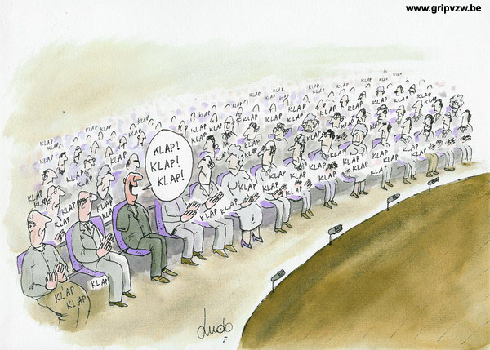

Slide 24
American Asociation on Intellectual and Developmental Disabilities (AAIDD), Intellectual Disability: Definition, classification and systems of supports; 11th edition (2010)
Buntinx, W.H.E. (2006). The relationship between the WHO-ICF and the AAMR-2002 system. In H: Switzky & C: Greenspan (Eds.), What is mental retardation? Ideas for an evolving disability in the 21st century (pp. 303-323). Washington, DC: AAMR. Schalock, R. L., Gardner, J.F., & Bradley, V.J. (2007). Quality of life for people with intellectual and other developmental disabilities. Applications across individuals, organizations, communities, and systems. Washington, DC.: American Assoviation on Intellectual and Developmental Disabilities.
Van Gennep A. en Steman C. Beperkte burgers : over volwaardig burgerschap voor mensen met verstandelijke beperkingen. Utrecht : NIZW, 2002
Van Hove G. en Roets G. ‘Empowerment’ en volwassenen met een verstandelijke handicap. In: Ghesquière P. en Janssens J. (red). Van zorg naar ondersteuning – ontwikkelingen in de begeleiding van personen met een verstandelijke beperking (pp41-52). Houten: Bohn Stafleu van Loghum, 2000. Presentation made by Sofie Sergeant, with the kind support of Stef Thienpont , Beatriz Miranda and Fiona Post
Sources

