Slide 1
Working together, learning together: Participatory research is a verb
Disability Studies in Nederland @ ECQI 2017
Henriette Sandvoort | h.sandvoort@lfb.nl
Sofie Sergeant |sofie.sergeant@disabilitystudies.nl

Slide 2
Two Researchers …
The film

Slide 4
Introduction
My name is Henriette Sandvoort.
For 9 years I work for the LFB: an advocacy organization of and for people with disabilities. I have an intellectual and visual impairment.
Within the LFB I work for the department ‘Education and training’.
We give training to people with and without disabilities, also often for professionals.
I also have an advisary role in several organizations, also on the UN Convention implementation.
Two days a week I work as a researcher, together with Sofie.
For 4 years we collaborate in the project ‘Working together, learning together’.
The NPG (National Programme for the Support of People with Disabilities) asked us to evaluate 6 projects on participation of people with disabilities in the research.
We try to get an overview of every project, we organize meetings and we evaluate the participation of the experts in experience, we coach and give training to project members.
We distribute good practice… And we learn from our own collaboration and our search for an equal relationshop.

Slide 5
In cooperation we meet.
I discover your talents. You discover mine.
I learn to know you talents. You learn to know mine.
I learn about your abilities and disabilities.
You learn about mine.
I learn to respect you, you learn to respect me.

Slide 6
It is very important to me that I know I can trust you. I need to feel safe and secure. Within this safetyness, we need to be able to give and receive feedback. I want you to be honest with me, in a respectfull way. And I will be honest with you, in a respectfull way.

Slide 7
Two researchers. At the deep blue see. Counting on each other. Communicating with each other. We need to tune the violins before and while we play.

Slide 8
The deep blue water can be discovered, observed, investigated, touched, stared at, dived in, played, studied, felt, stirred up, analyzed, tasted, used, heard, compressed, scanned, destroyed, cleaned up, researched, explored, touched, jumped into, brought to light, evaluated, screened…

Slide 9
We learn, observe, interview, write, talk, think and evaluate. We search for inspiring and inclusive research practice and we try to bring this to light.

Slide 10
We want to bring change. Change in how people think about people with disabilities. We want to give people with disabilities a voice and a more leading position: in research, in working, in contributing, in living.

Slide 11
We are a project too. We look at ourselves and we learn from each other. We try to connect. Through our research we get to know each other. This is very important to us.

Slide 12
We love good food. We love fast cars. We enjoy the pub life. We love riding without a roof “with the wind in our hair”. We love music and dancing. We are both women, age 41. We like men with humour. We love traveling and being on the road. We go running every week. We…

Slide 13
We work hard. Sometimes we are on the same wavelength. Sometimes we struggle. And that’s ok.

Slide 14
Henriette: “Sofie, I know what you need. Structure. And I can help you with that.”

Slide 15
Disability Studies &
Participatory Research
Sofie:
„I do not give you homework.“
„I do not have the answers.“
„I don‘t know what is the best road to take.“

Slide 16
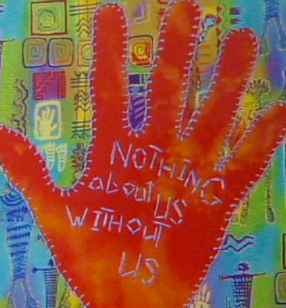
Nothing without us about us
People with disabilities have lived experience = very important knowledge and experience.
! Experience of stigma: caused by
Status quo
Labeling
Stereotyping
Discrimination
Separation

Slide 17
Universal Design
One size does not
fit all!
We are searching, exploring and creating
alternative and
creative research
methods.
Notes:
How could universal design improve your life?

Slide 18
Presentation made by DSiN Sofie Sergeant – Education Coordinator DSiN – sofie.sergeant@disabilitystudies.nl
Reading tips
www.disabilitystudies.nl

Slide 19
