Slide 1
Selcuki & Ali
www.selcukiali.com

Slide 3
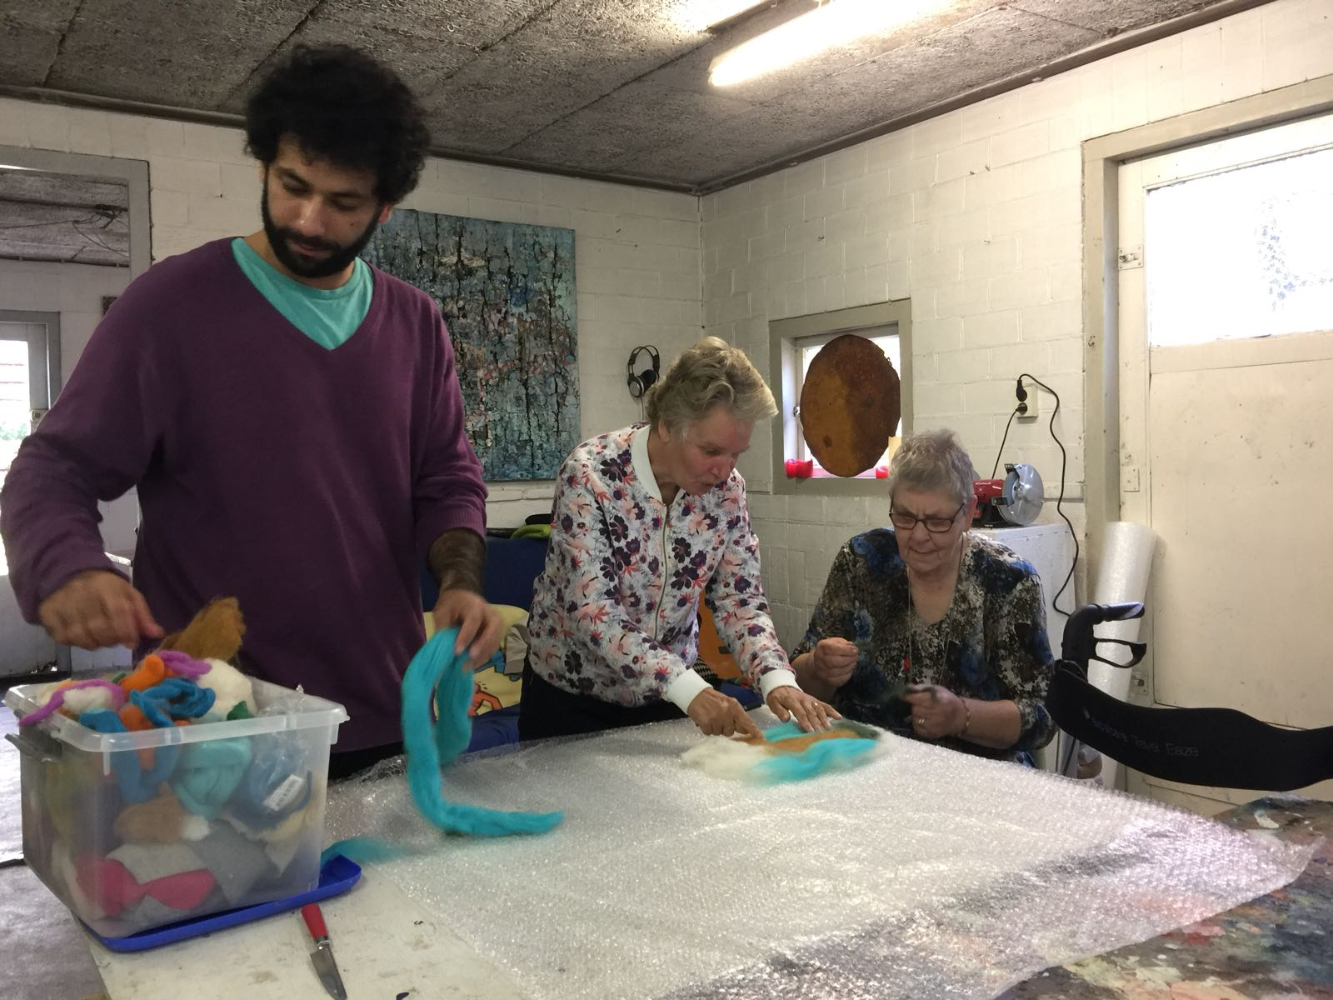
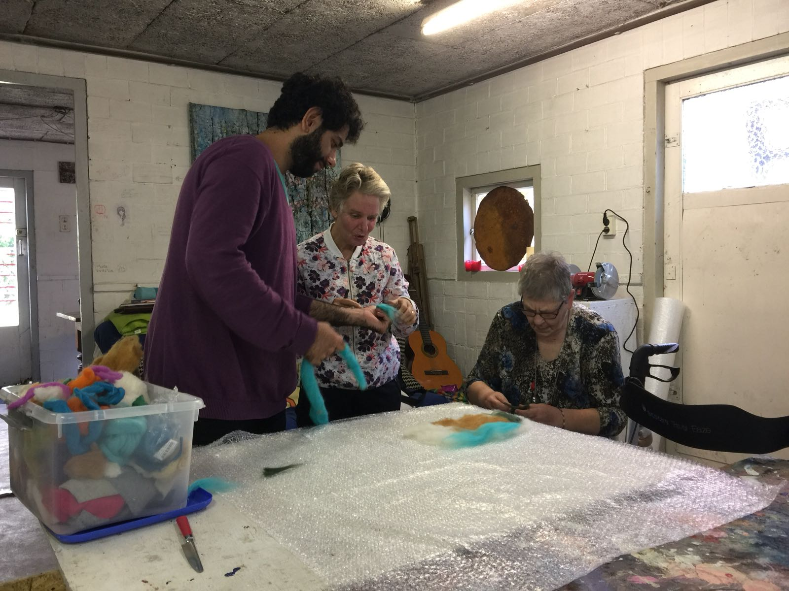
n
Materieschilderen
Amsterdam

Slide 4
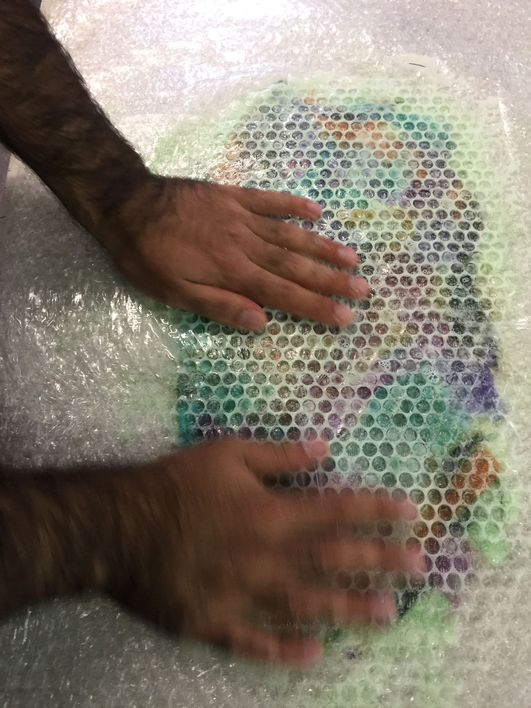

Slide 5
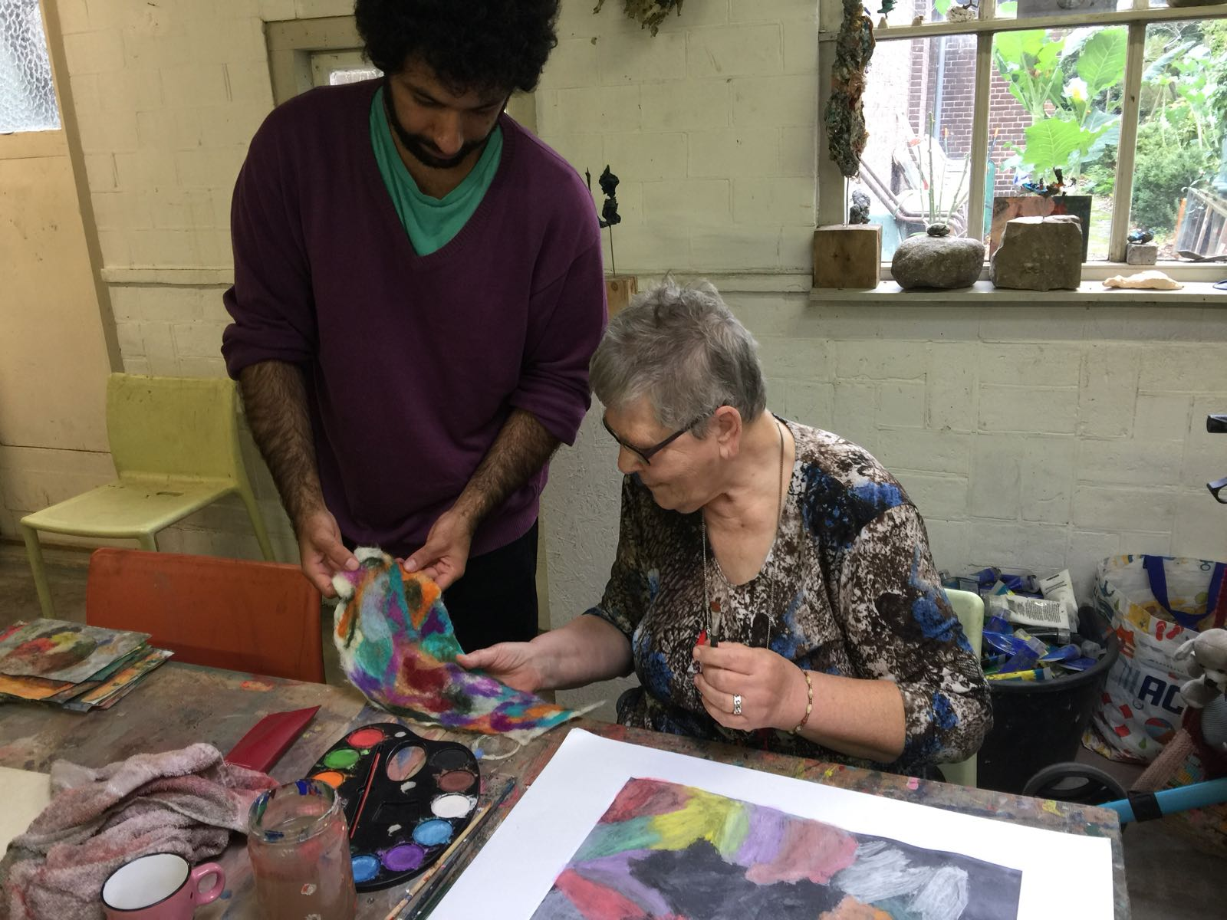

Slide 6
DEEL 2

Slide 7
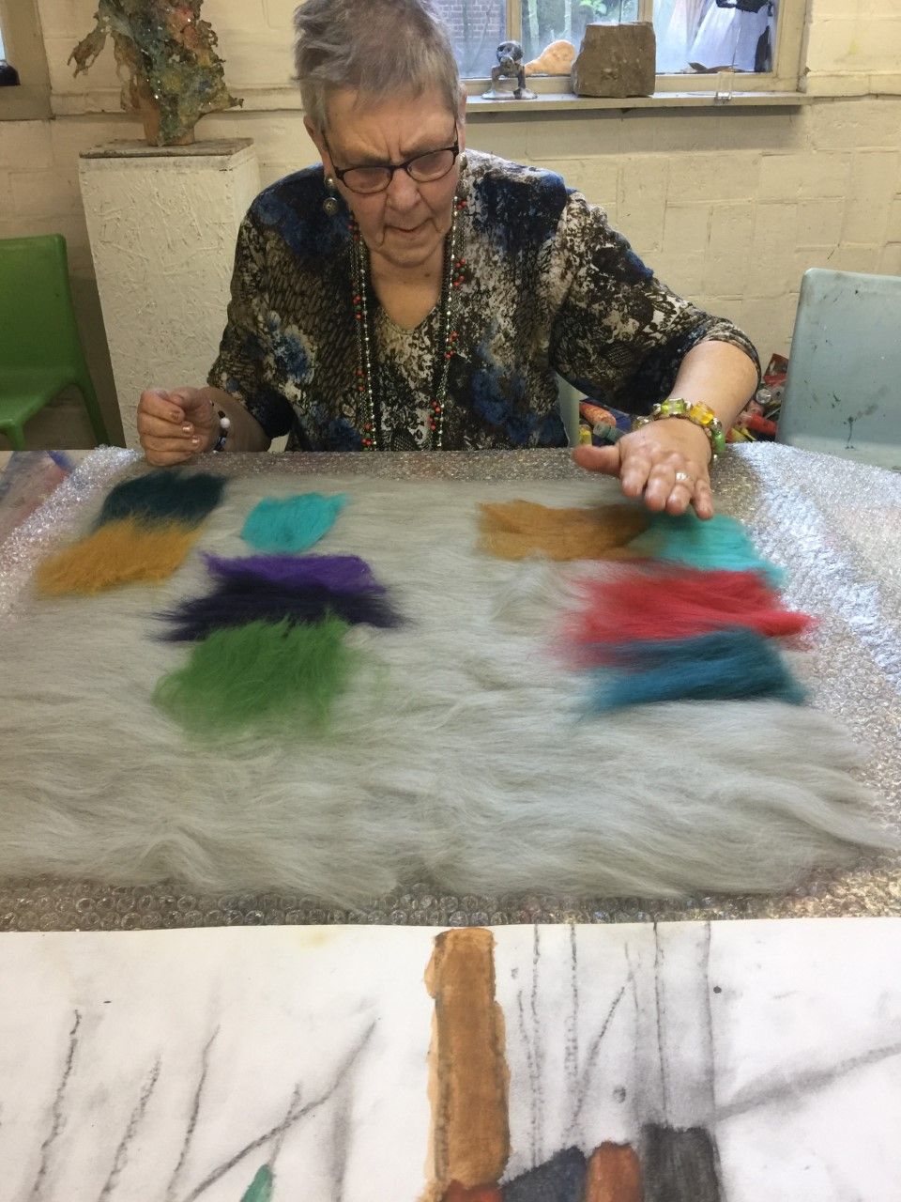

Slide 8
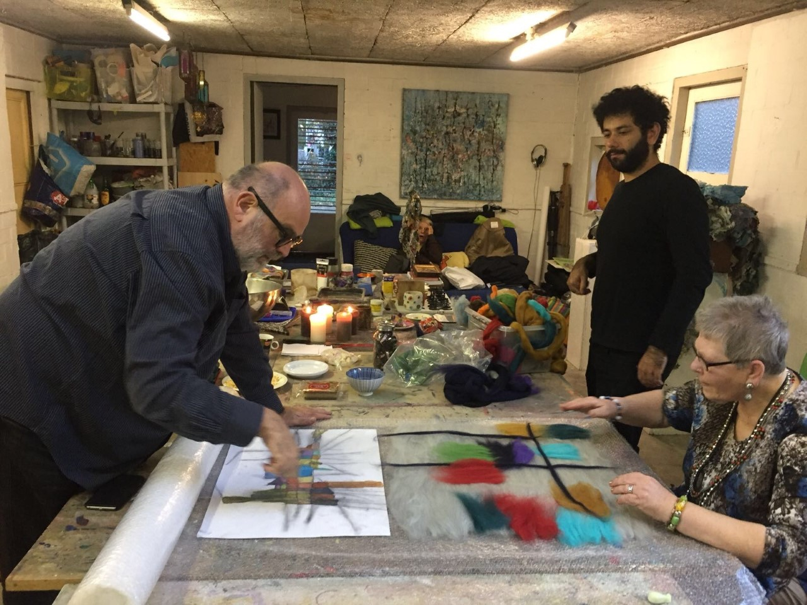

Slide 9
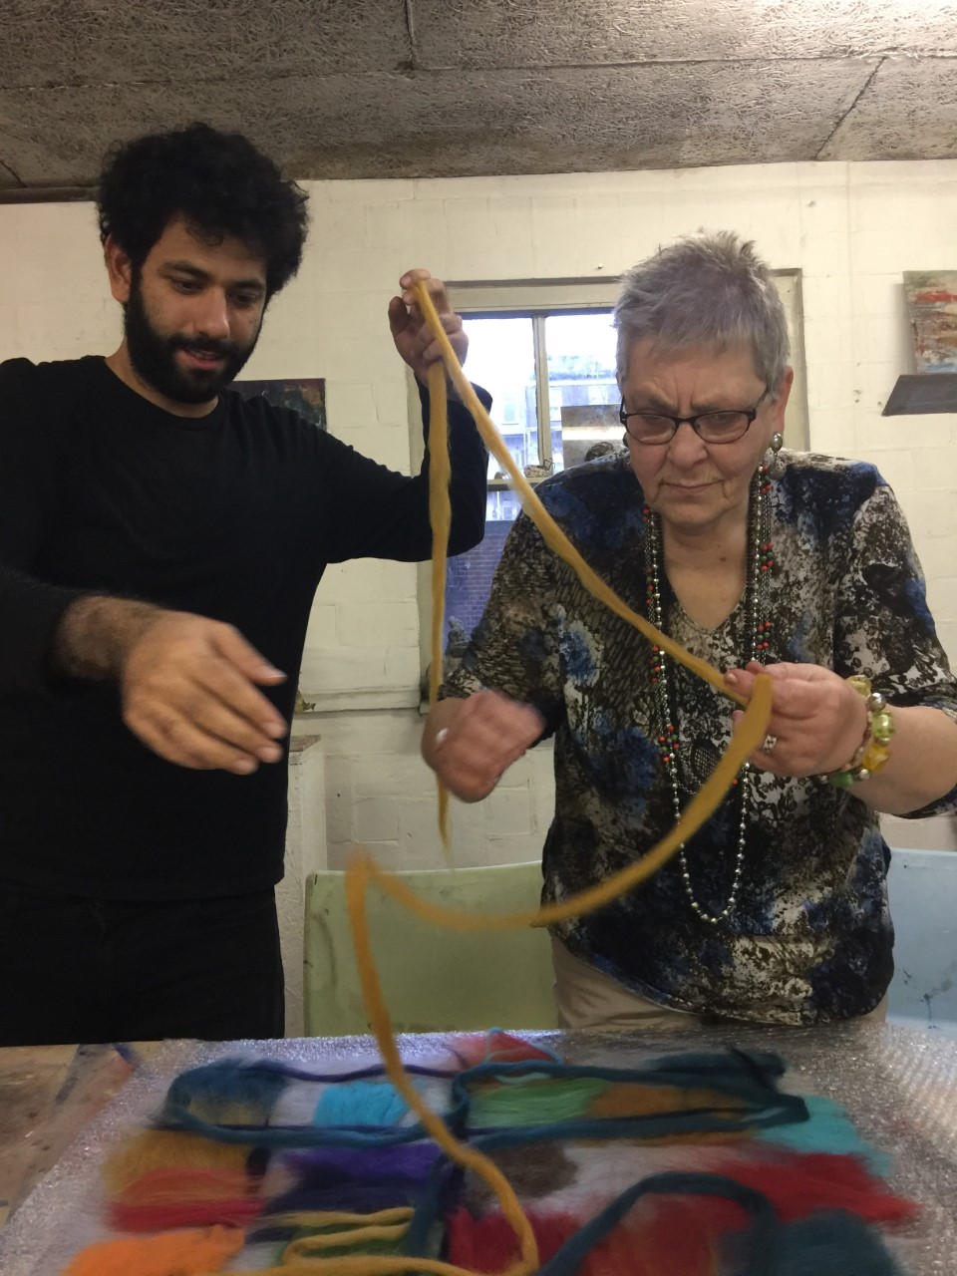

Slide 10
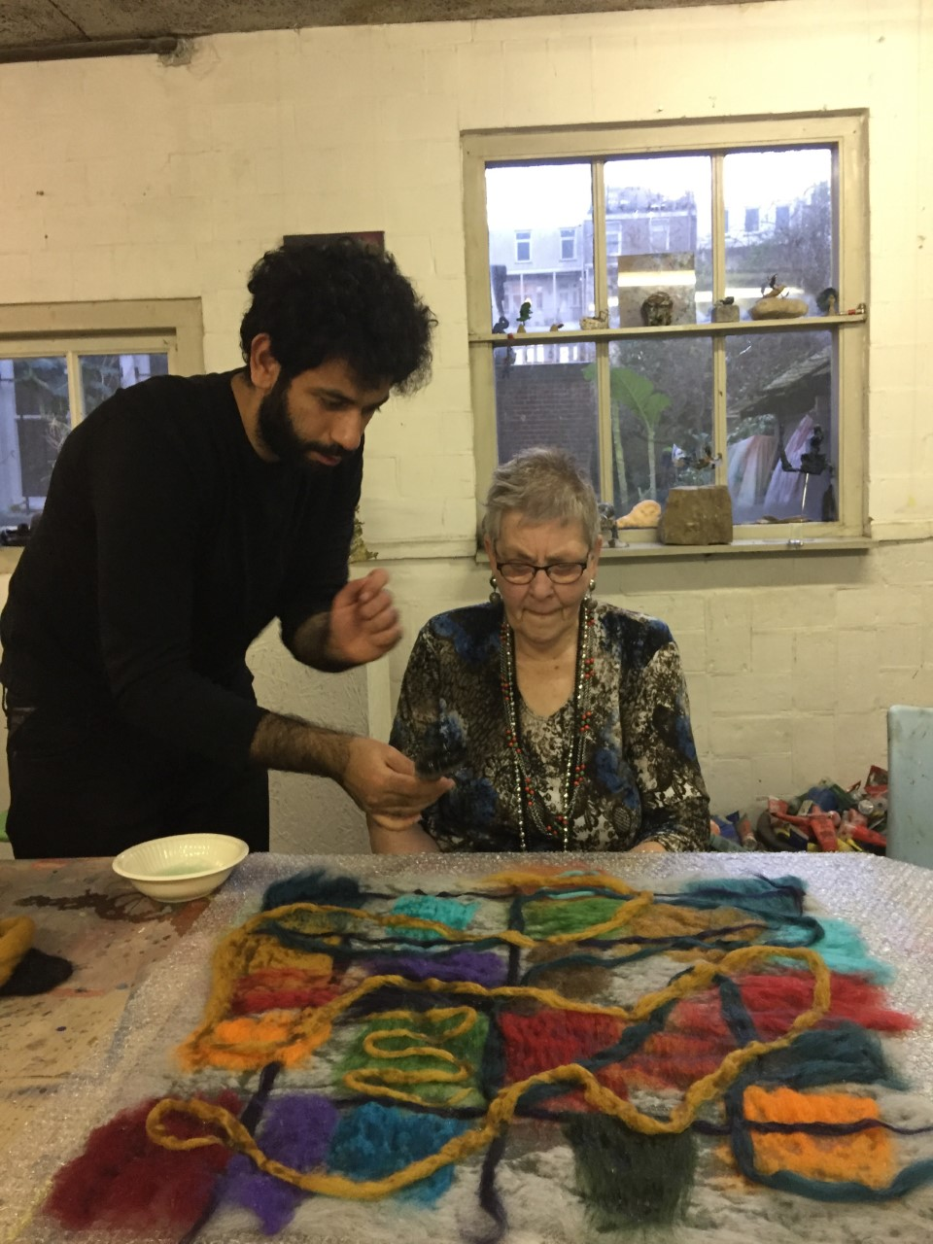

Slide 13
Wish it,
Dream it,
Do it!
Materieschilderen
Amsterdam

